Slide 1
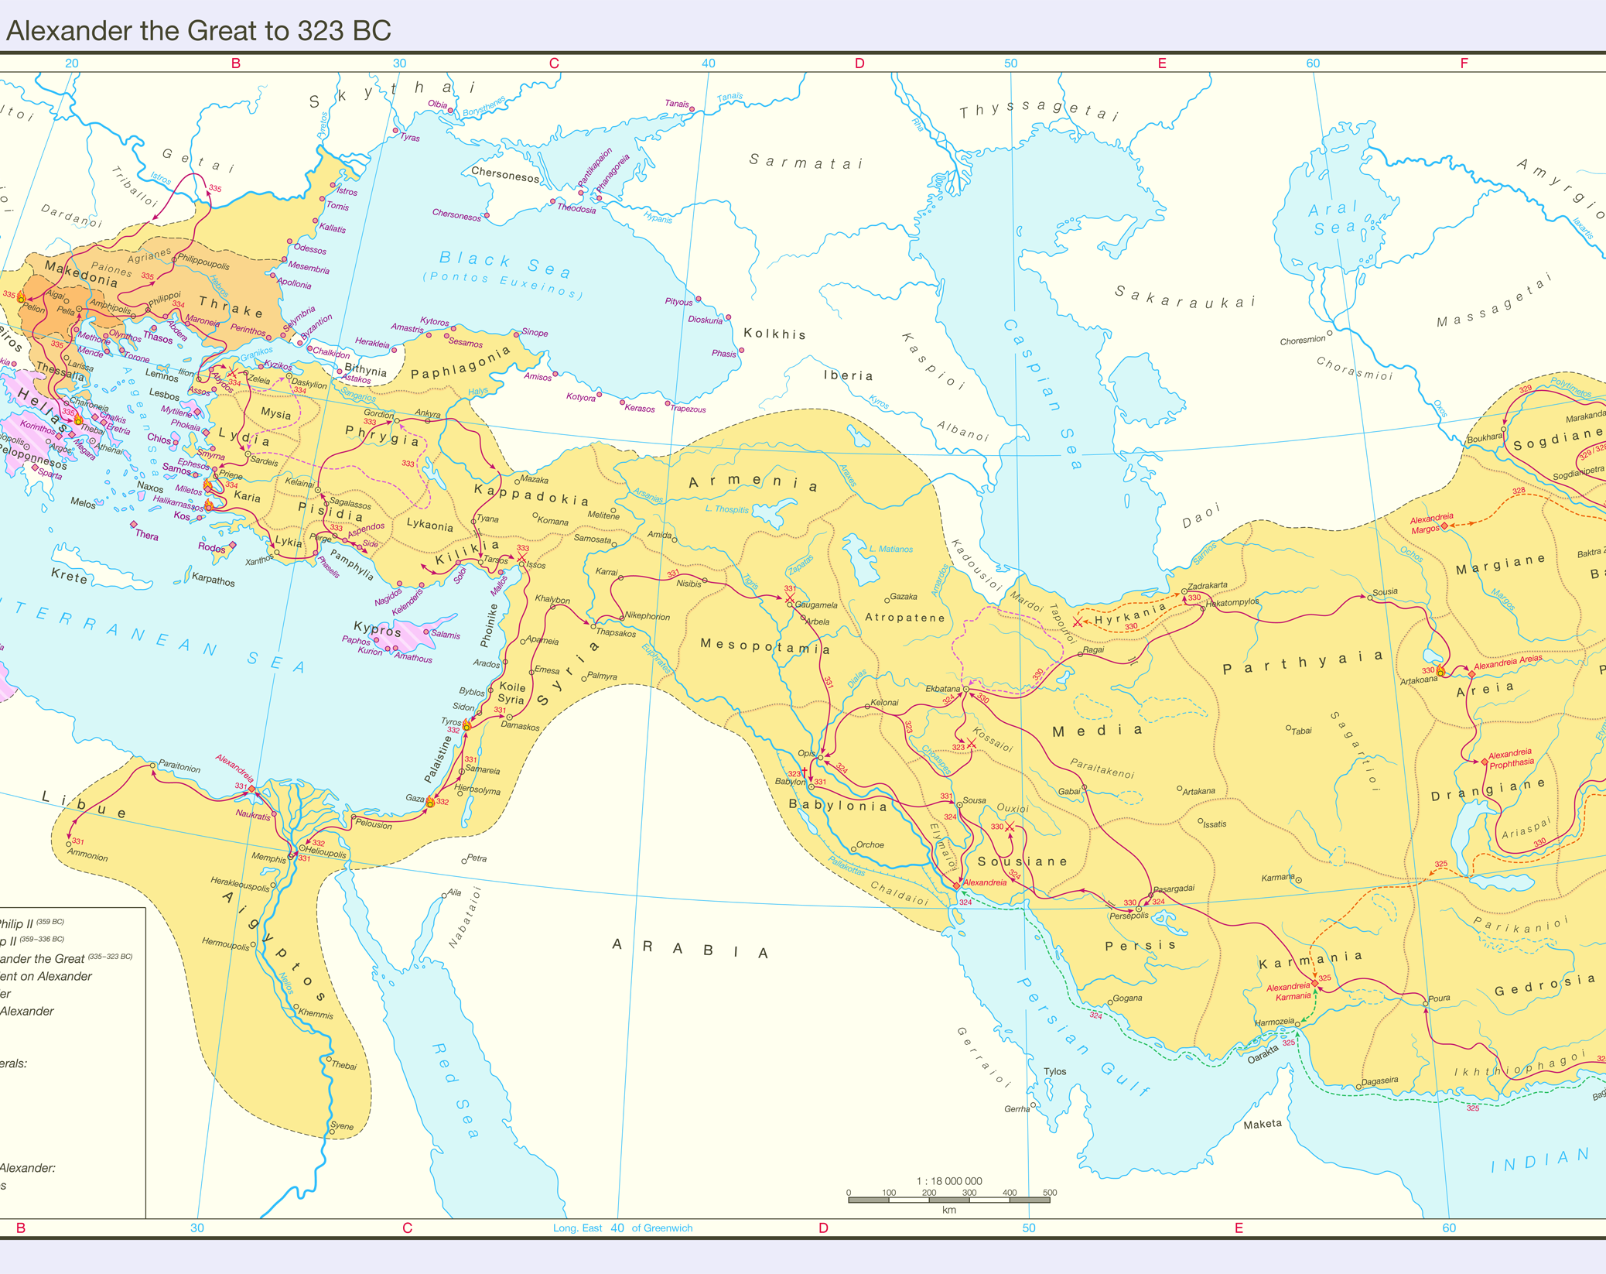
IronHack Project 1-Risk
By: Miguel Chacón
Teacher: Guillem Perdigó

Slide 2
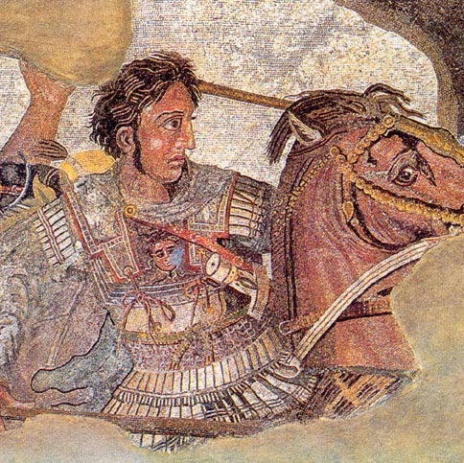
The Game - Alexander
The game takes place in 334 BC and follows the historical campaigns of Alexander the Great.

Slide 3
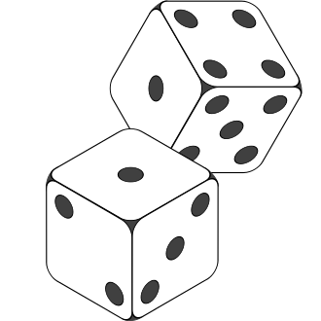
Rules
The player must capture all nine regions to win.
The player has 27 infantry.
Each region is defended by 3 infantry.
Once the player decided to attack a region, they must keep attacking until the defender falls or the attacker is defeated.
Once a region falls, the attacker moves on to attack a new one

Slide 4
Battle Mechanics
The attacker rolls a number of dice that matches the number of troops they have, up to a maximum of three.
The defender rolls a number of dice that matches the number of troops they have, up to a maximum of two.
Each player’s highest and second highest dice is matched, respectively.
Each player loses a piece of infantry for each dice match they lose.
If two dice of the same value are matched against each other, the defender wins that die.

Slide 5



The code
Definitions
Input Function
Dice Function
Regions available are keys in a dictionary. Number of soldiers are elements.
Empty list with regions held by player.
Input must be region from dictionary
If the input is valid and the region is not captured, it connects to dice function and displays soldiers on each side.
If no regions remain, the game ends.
If the player has no troops remaining, the game ends.
Six combinations in total – one for each combination of dice.
If region is captured, it is added to the captured list and the input function is launched.
If the player has no troops remaining the input function is launched.

Slide 6
Let’s check it out!

